Slide 1

FOOD IN THE LIFE OF MAN

Slide 2
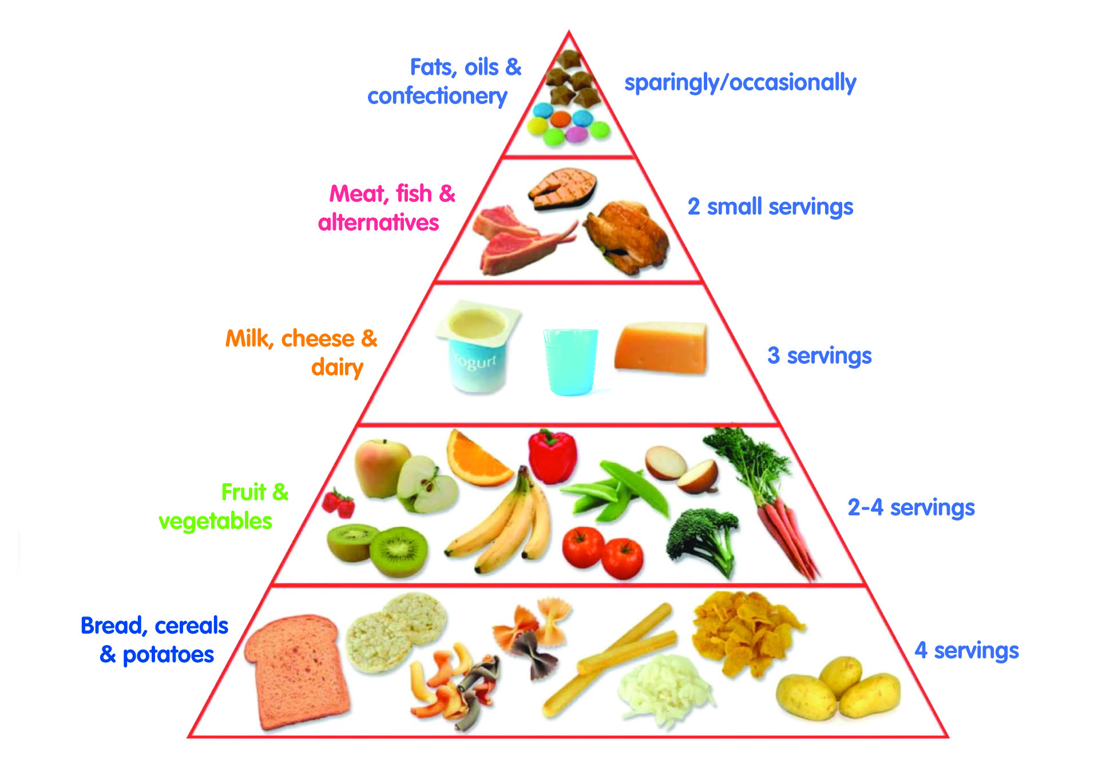
TO NOURISH THE BODY

Slide 3

TO SATISFY HUNGER

Slide 4
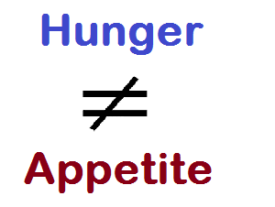
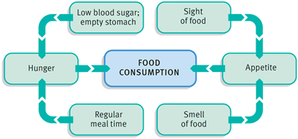
HUNGER VS APPETITE

Slide 5
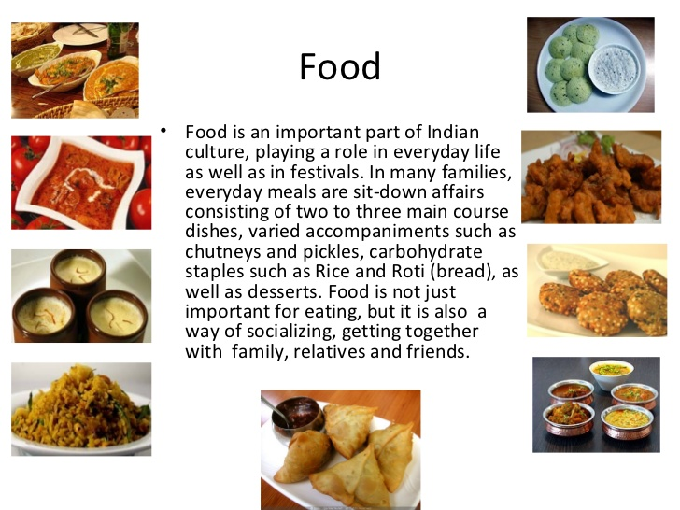
TO SATISFY CERTAIN SOCIAL NEEDS

Slide 6

FOODWAYS OF MAN

Slide 7

TO ACHIEVE CERTAIN PSYCHOLOGICAL NEEDS

Slide 8
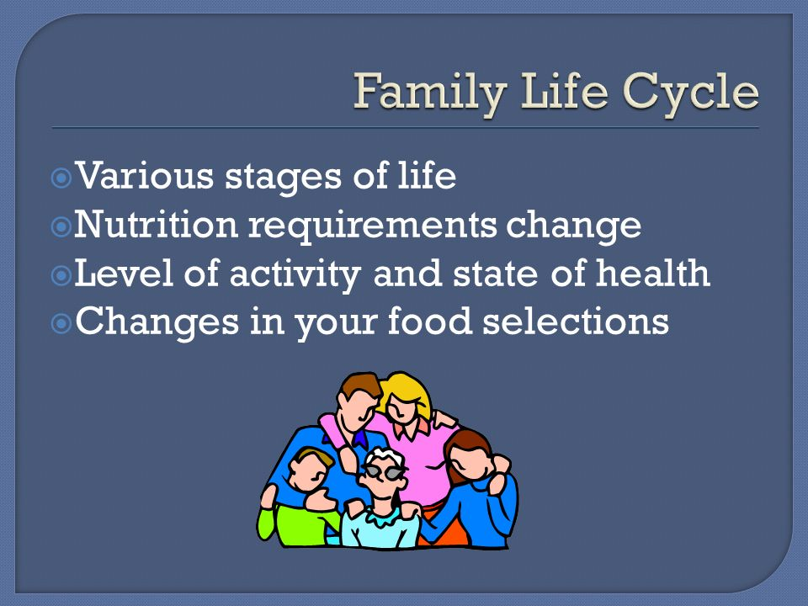
FOOD - CHANGING NEEDS WITH THE LIFE CYLE

Slide 9
FOOD JUSTICE
AFFORDABLE
ACCESSIBLE
HEALTHY
SUSTAINABLE

Slide 10

RECOMMENDED DIETARY ALLOWANCES

Slide 11
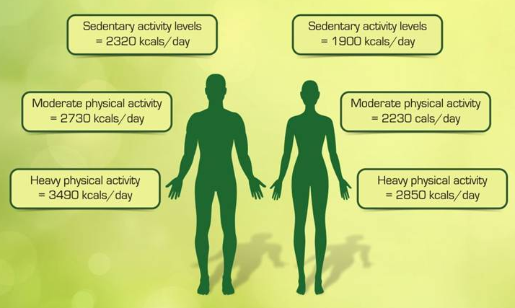
RECOMMENDED DIETARY ALLOWANCES

Slide 12
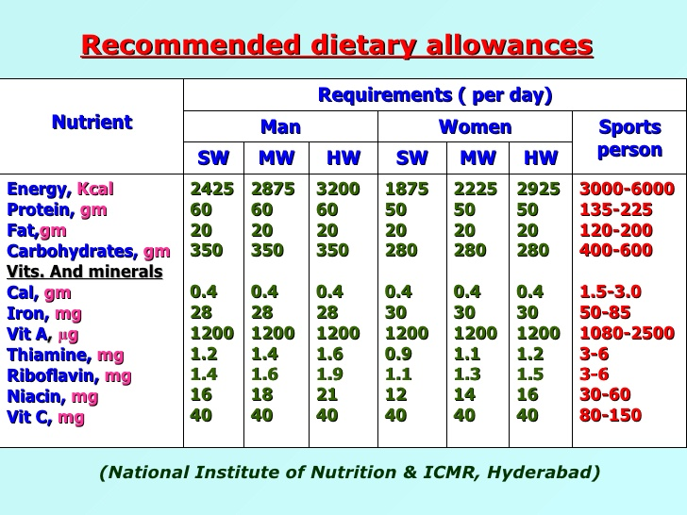
RECOMMENDED DIETARY ALLOWANCES

